Slide 1
AD MIGRATION (LIFT AND SHIFT)

Slide 2
Pre-requisite Check

Slide 3
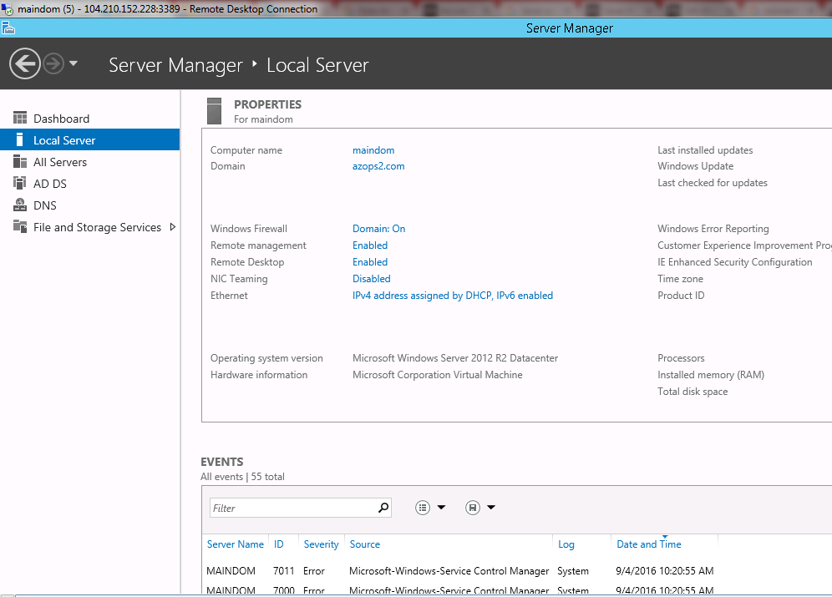
RDP must be enabled in the AD before migrating that to Azure

Slide 4
Vboxmanage clonehd vdifilepath vhdfilepath –-format VHD
Convert to VHD (if required)

Slide 5
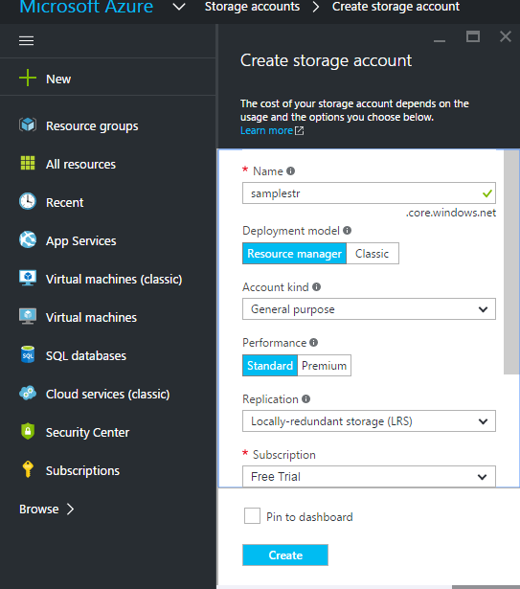
Create a Storage Account in Azure to store VHD

Slide 6
Upload VHD to Azure
Add-AzureVHD –Destination “storageaccounturl/container/filename.vhd” –LocalFilePath “Localvdifilepath”

Slide 7
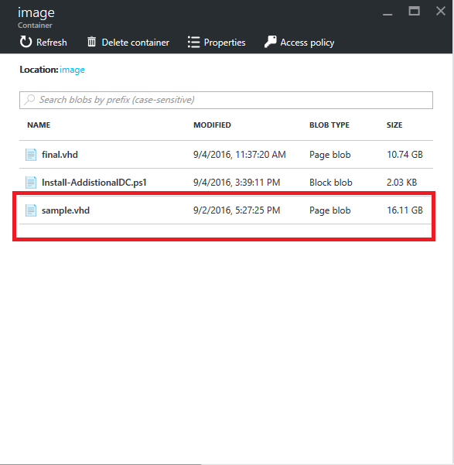

Slide 8
Create Virtual Network and Subnet

Slide 9
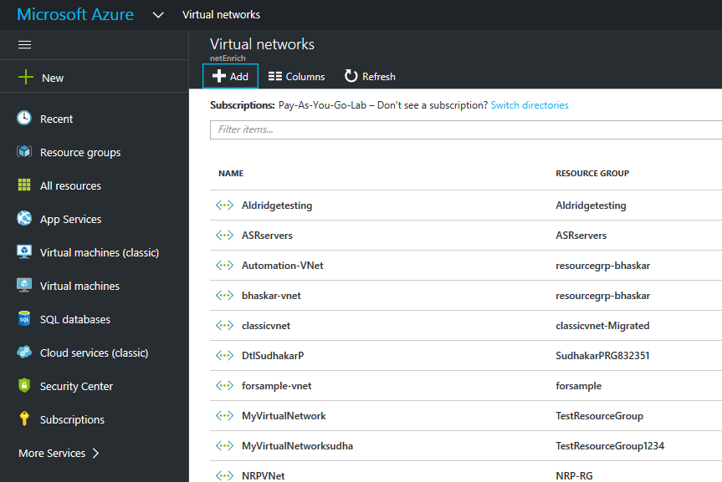
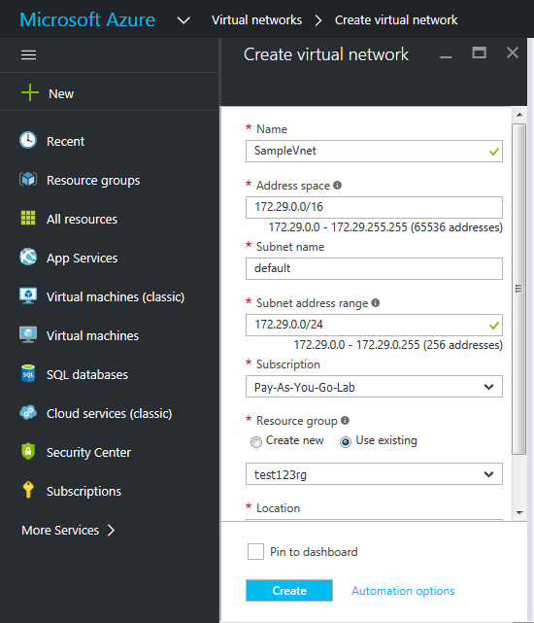
Create Virtual Network

Slide 10
Create VM with that VHD in the created Virtual Network

Slide 11
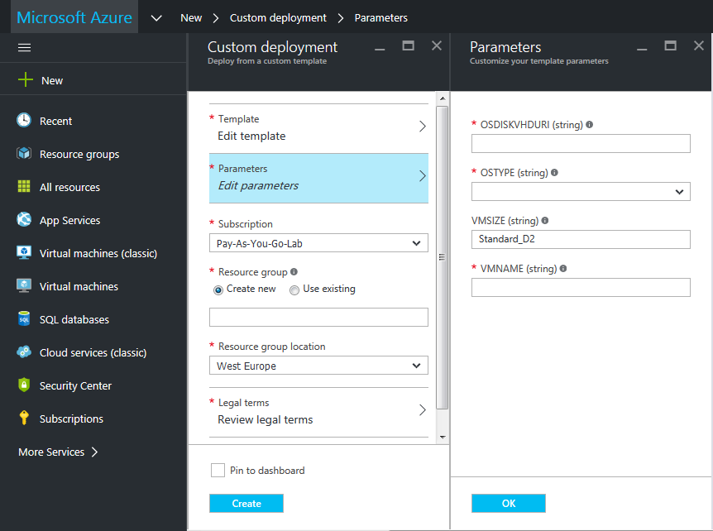
Create Virtual Machine with that VHD. https://azure.microsoft.com/enus/documentation/templates/201-vm-from-specialized-vhd/-------------(Template Link )

Slide 12
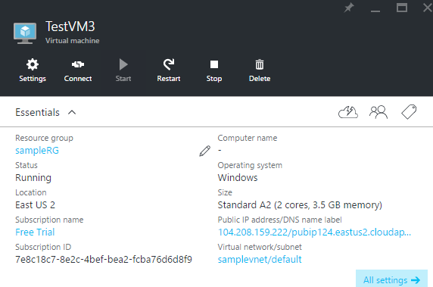
Successfully created a VM with that VHD

Slide 13
